Slide 1
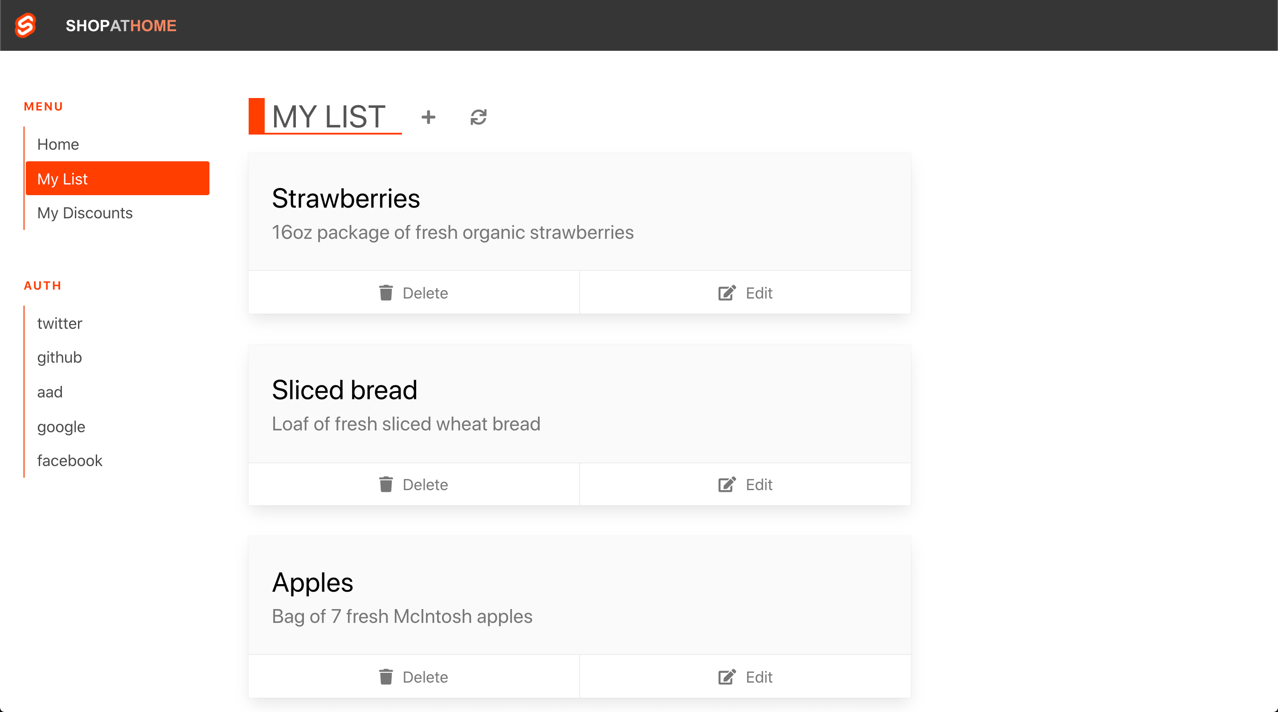



Your code
Notes:
Let’s say that you build an app that connects people who need groceries with those who can provide them.
You can develop this today, but can you deploy it today?
Let’s think about what you need to do to get it to your users …

Slide 2
Your code
Notes:
You wrote your code

Slide 3

Push to GitHub
Notes:
Y

Slide 4

CI/CD
Notes:
What do you need to do to get all of this?

Slide 5

APIs
Notes:
What do you need to do to get all of this?

Slide 6

Your App to API
Notes:
What do you need to do to get all of this?

Slide 7
www
SSL and Custom Domains
Notes:
What do you need to do to get all of this?

Slide 8

Authentication
www
Notes:
What do you need to do to get all of this?

Slide 9

Security Roles
www
Notes:
What do you need to do to get all of this?

Slide 10
Global scale
www
Notes:
What do you need to do to get all of this?

Slide 11
?
?
www
Notes:
What do you need to do to get all of this?

Slide 12
www
Notes:
What do you need to do to get all of this?

Slide 13
Notes:
Angular

Slide 14
Notes:
React

Slide 15
Notes:
Svelte

Slide 16
Notes:
And Vue
These tools have fundamentally changed the way we build web applications. Instead of a server runtime that makes database queries and builds pages dynamically when they are requested, these new JavaScript powered applications run entirely in the browser. We have moved the application responsibilities of the server, entirely into the client.

Slide 17
Notes:
There’s now a build process required on the client side.

Slide 18
$> npm run build
Notes:
All of your code for your application has to be built before it can be deployed.

Slide 19

$> npm run build
Success!
$>
/build
index.html
main.min.js
main.min.css
Notes:
What you get out of the other end of that build process is just some “static” files. We call them ”Static”, because they don’t change. They don’t require a web server to build them dynamically like with ASP.NET, PHP or JSP.
In fact, we don’t really need much of a web server at all. All we need is to return these files just as they are. This is almost a throwback to a time when the web wasn’t full of dynamic applications rendered by servers. We’re back to just the core components of the web

Slide 20
$> npm run build
Success!
$>
/build
index.html
main.min.js
main.min.css
Notes:
… HTML, CSS, and JavaScript
Traditional web servers don’t handle the build steps these apps require. We need a fundamentally new kind of cloud service for these new applications.

Slide 21
Azure Static Web Apps
From <code/> to global scale
/build
index.html
main.min.js
main.min.css
Building a static web app in minutes
Notes:
Introducing Azure Static Web Apps

Slide 22
From <code/> to global scale
Building a static web app in minutes
Notes:
Hi, I’m John Papa. Today you’ll learn how to take your code to global scale in minutes with Azure Static Web Apps

Slide 23
From <code/> to global scale
Building a static web app in minutes
Notes:
Let's go from your code to global scale …

Slide 24
From <code/> to global scale
Building a static web app in minutes
Notes:
… You’ll be building static web apps in minutes.

Slide 25
Azure Static Web Apps
Notes:
What is Azure Static Web Apps?

Slide 26
Azure Static Web Apps
build and host static web apps
Notes:
It’s a new Azure Service for building and hosting static web applications,
A complete platform for building and hosting static web apps

Slide 27
build and host static web apps
authentication and authorization
Notes:
You get authentication and authorization

Slide 28
build and host static web apps
authentication and authorization
APIs powered by Azure Functions
Notes:
And it features API’s powered by Azure Functions

Slide 29

build and host static web apps
authentication and authorization
APIs powered by Azure Functions
CI/CD powered by GitHub Actions
Notes:
and a CI/CD pipeline powered by GitHub Actions that's automatically setup for you.

Slide 30

CI/CD powered by GitHub Actions
Notes:
Simply put, Static Web Apps
Takes your source code to GitHub …

Slide 31

Notes:
… Builds and deploys your code …

Slide 32
Notes:
All the way to global availability.
So you can focus on building your app.

Slide 33








STATIC WEB APPS
REPO
STATIC CONTENT
HTML/JavaScript/CSS
app
PUSH/PR
ACTION
api
API
Azure Functions
Notes:
So how does this work?
You create an Angular, React, Vue, Svelte Static Site generator or even just an index.html page.
If you want an API, you create an “api” folder in your project and add in some Azure Functions endpoints.
You push your code to GitHub, and Azure Static Web Apps creates the GitHub Action to build your project and then deploys it a geo-replicates it to 5 regions immediately.

Slide 34
Publishing Your App
Static assets are globally distributed
Automated builds with GitHub Actions
Free SSL certifications for your custom domains
Notes:
When publishing your app …

Slide 35
Demo Publishing Your App
Notes:
Now let’s see how to publish your app

Slide 36
Publishing Your API
And we’ll add that fallback route!
Staging/Preview URLs
Built-in support for API’s powered by Azure Functions
Automated CI/CD with GitHub Actions workflow
Notes:
Often your apps need data. You can make a pull request for your APIs and deploy your app to s staging URL, where you can preview your APIs, powered by Azure Functions. This is all automated by GitHub Actions

Slide 37
Demo Publishing Your API
Notes:
Now let’s see how to publish your API and fix that fallback route

Slide 38
Auth and Protecting Your Routes
Authentication
Role based authorization
Full control over routing
Notes:
You have control over how users authenticate with your app. You can choose form from several auth providers including GitHub, Twitter, and Azure Active Directory
You can assign roles to your users
And you can secure your API routes so only those with the proper authentication and role can access them

Slide 39
Demo Auth and Protecting Routes
Notes:
Now let’s see how to establish authentication and role based authorization in your apps …

Slide 40
Azure Static Web Apps
www
Notes:
Azure Static Web Apps is feature rich.

Slide 41
Azure Static Web Apps
www
Notes:
Because It’s built for the client-side it gives us a chance to focus on other things besides the server.

Slide 42
www
Notes:
And all of this comes together in one easy to use service

Slide 43
Azure Static Web Apps
Single unified workflow with GitHub Actions
Serverless APIs powered by Azure Functions
Integrated Auth with flexible roles and access
Notes:
Single unified workflow based on GitHub actions from source code to cloud
Easy to add serverless APIs powered by Azure Functions to extend your app
Integrated Auth with flexible role and access definitions

Slide 44

Notes:
Alright, you're getting all of what you just saw ... but how much is this going to cost you? That's a fair question.
I'd like you all to close your eyes. It's OK, close them. Work with me here .... What do you see? <nothing> Exactly. What you just saw , you can do that for free!

Slide 45
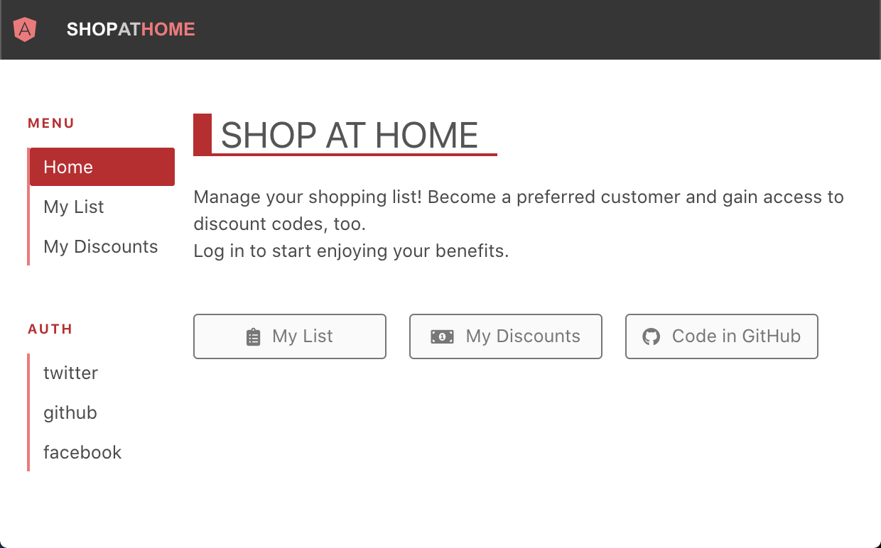
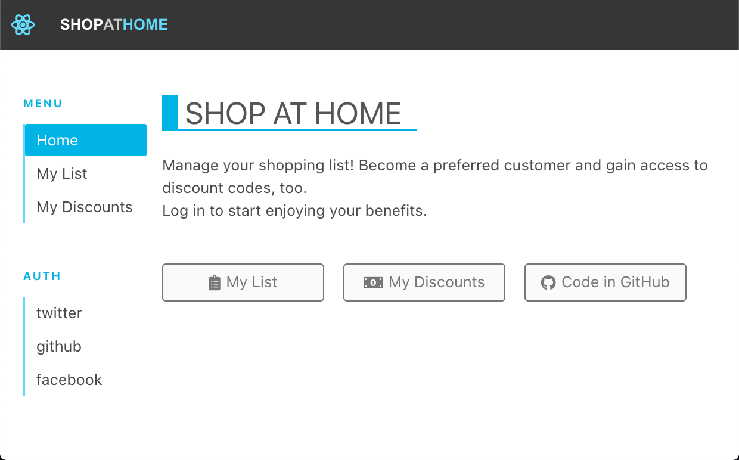
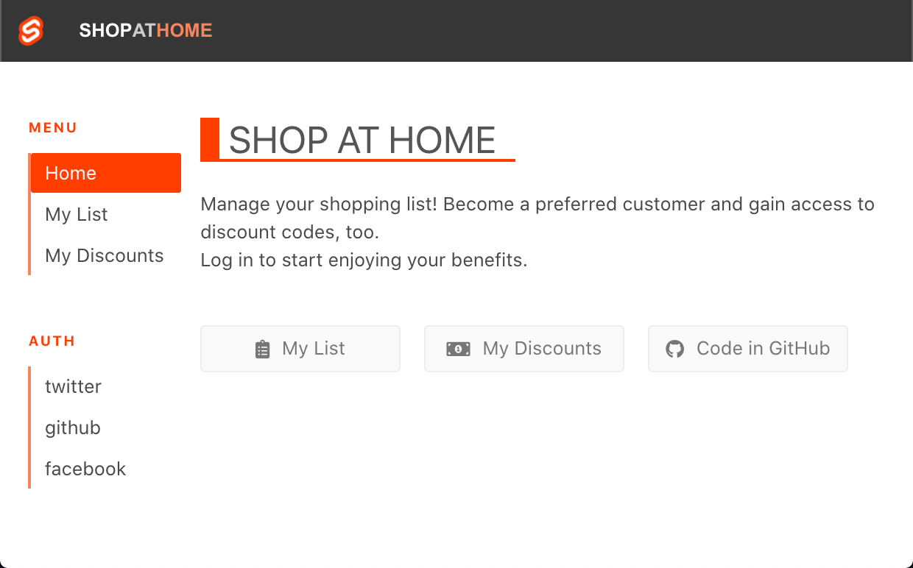
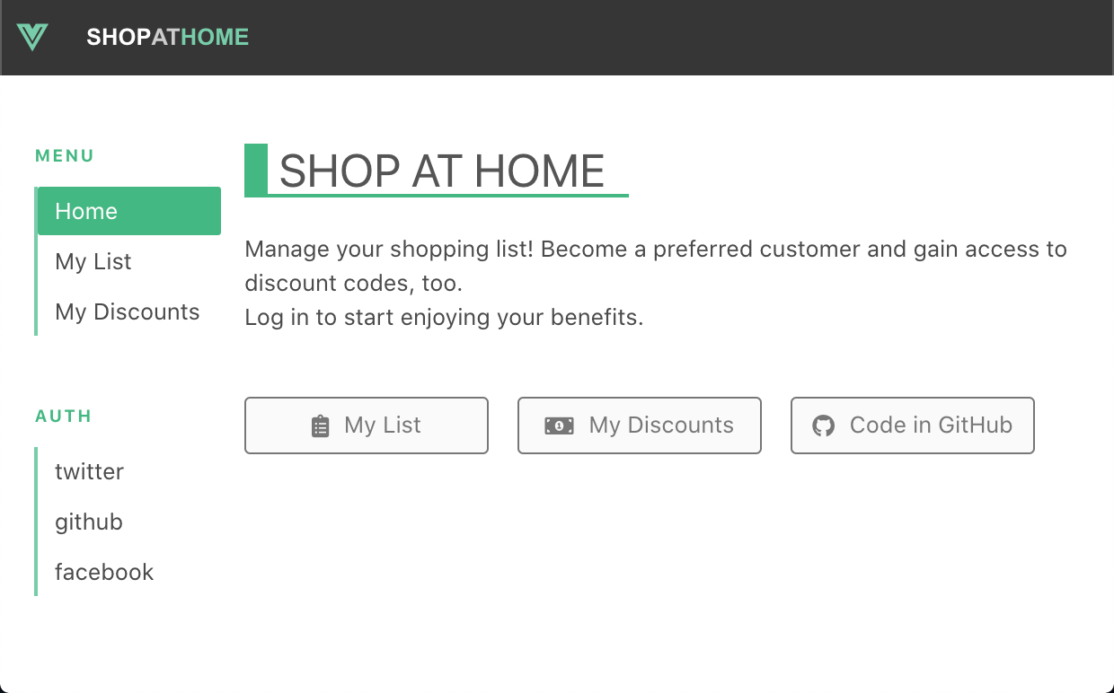
Static Web Apps Resources
Microsoft Docs
aka.ms/swadocs
Notes:
You can learn more and try it yourself

Slide 46
Static Web Apps Resources
Microsoft Docs
aka.ms/swadocs
Microsoft Learn
Publish Angular, React, Svelte, or Vue aka.ms/swaframeworks
Publish Gatsby
aka.ms/staticsitegen
Notes:
Using our documentation

Slide 47
Static Web Apps Resources
Microsoft Docs
aka.ms/swadocs
Microsoft Learn
Publish Angular, React, Svelte, or Vue aka.ms/swaframeworks
Publish Gatsby
aka.ms/staticsitegen
Notes:
And learn to publish your own web apps through hands-on learning, with Microsoft Learn

Slide 48
Static Web Apps Resources
Microsoft Docs
aka.ms/swadocs
Microsoft Learn
Publish Angular, React, Svelte, or Vue aka.ms/swaframeworks
Publish Gatsby
aka.ms/staticsitegen
Notes:
Using your favorite JavaScript library with Azure Static Web Apps.
You can build and deploy apps that are fast, secure and reach global scale with azure static web apps.

